Slide 1
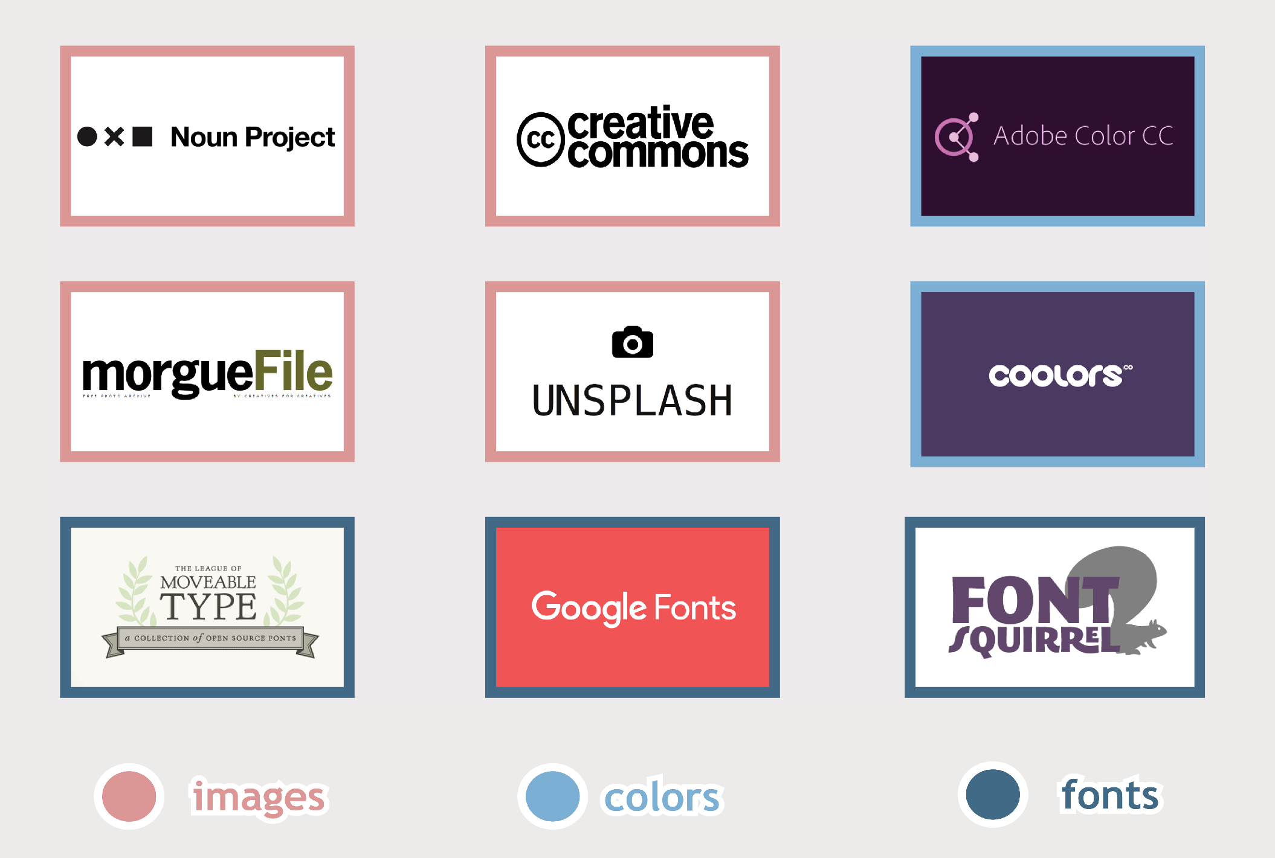
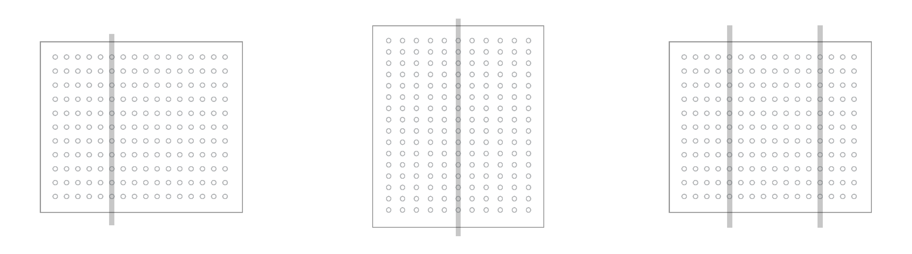
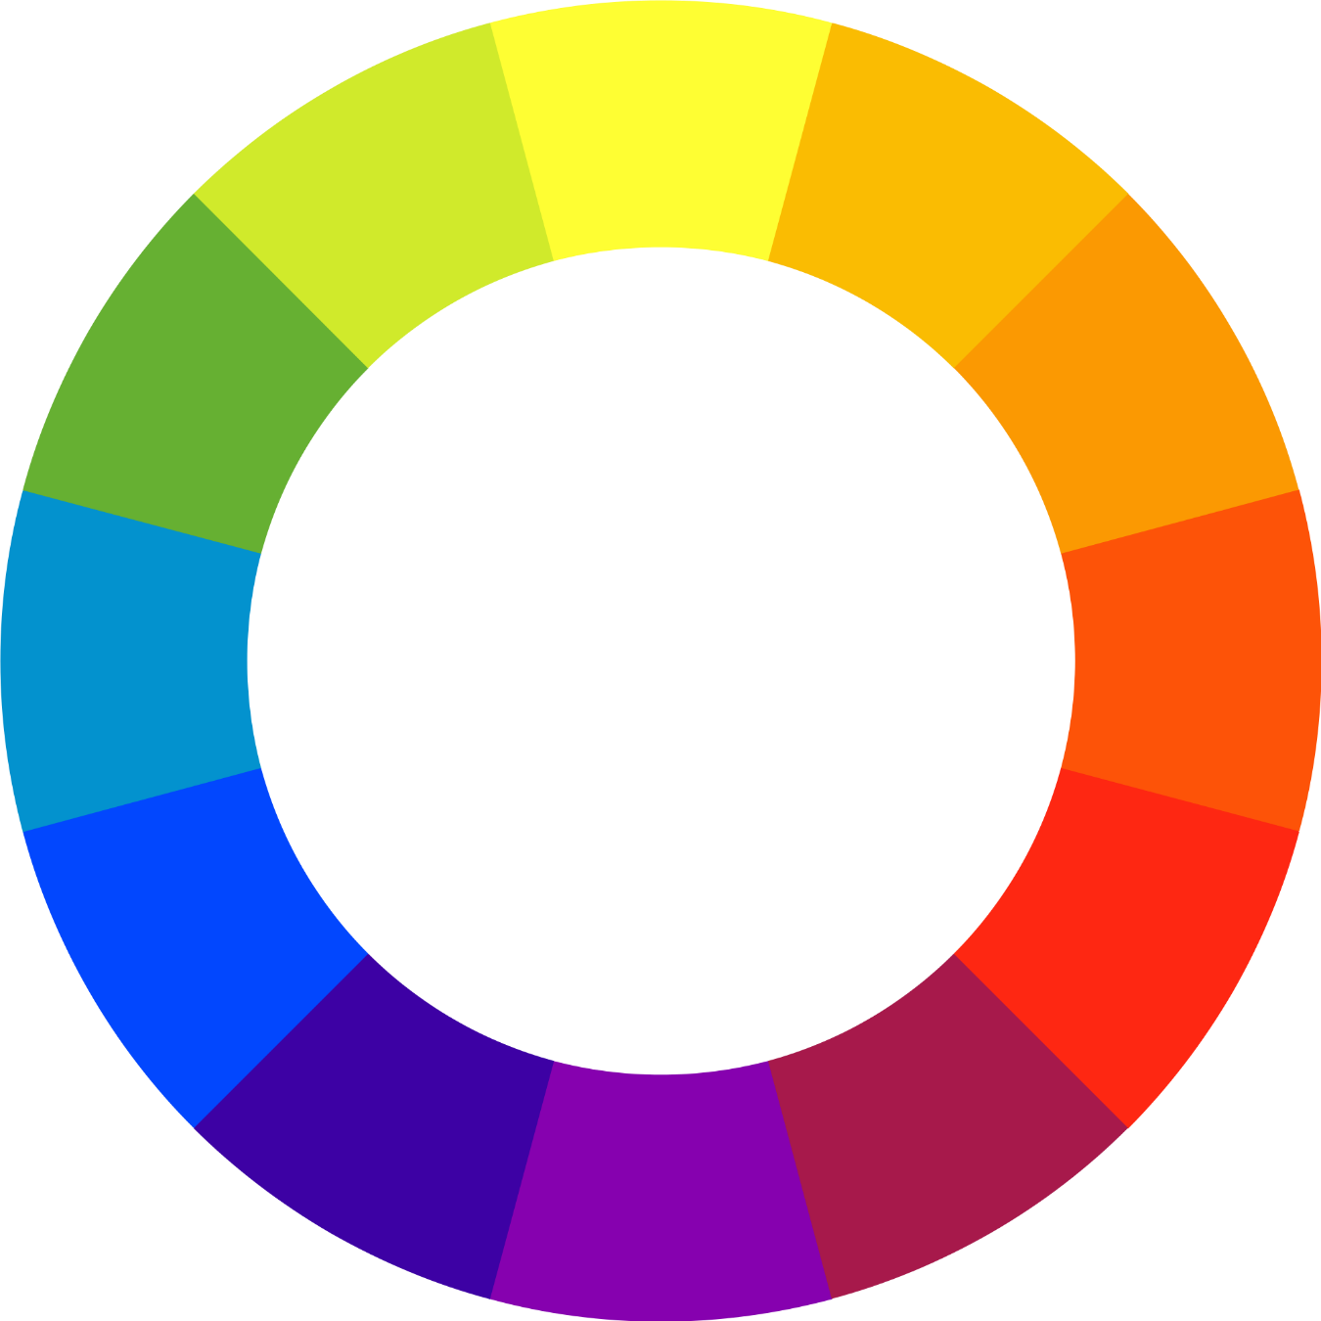
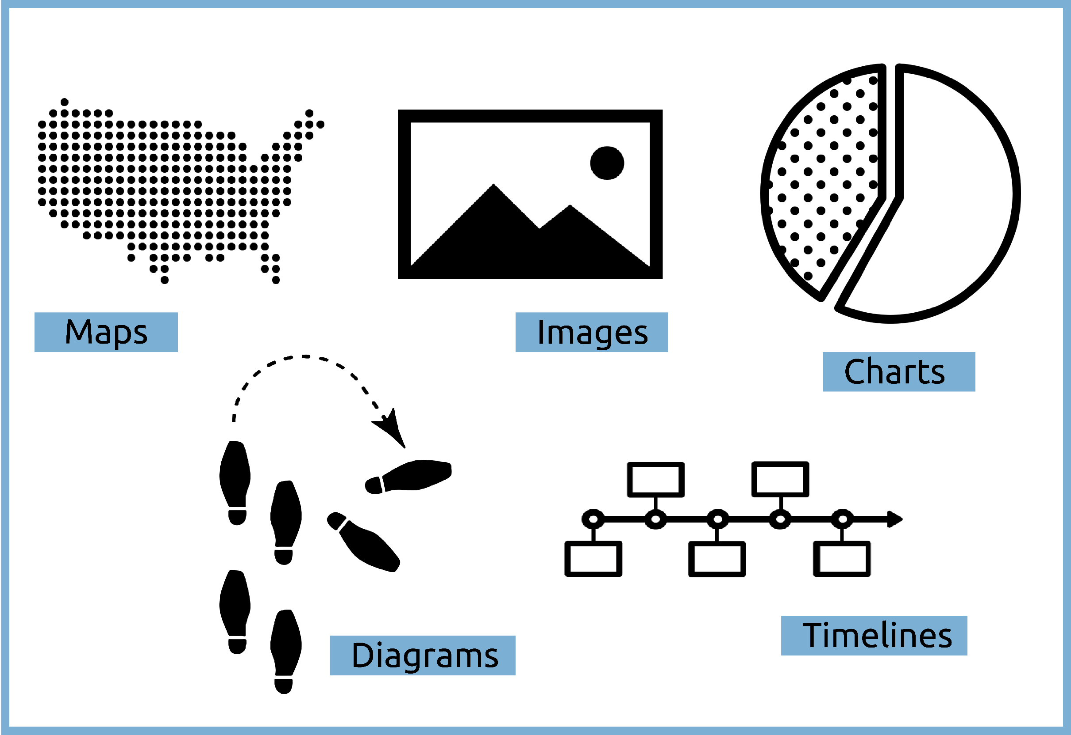
HOW TO MAKE AN AWESOME ACADEMIC POSTER
Robert B. House Undergraduate Library
^{How to Use This Template}
^{Layout}
^{Resources}
This template is built to help you create an awesome academic poster! Nothing on this template is permanent. You can delete, move, color, and shape to your specifications. To start, delete text by clicking in a text box, highlighting all the text in a box, and pressing delete. Next delete visuals by clicking on the visual and pressing delete. Most of the tools you will need will be located on the ribbon at the top of the page under [Insert] and [Home]. [Insert] will help you add pictures and text boxes. Under [Home] you will find options for text and paragraph properties, shape creation, alignment, and list arrangement. You can zoom in and out on the document by using the zoom slider at the bottom of the page.
Layouts are usually divided into 2 or 3 columns with 2” of space between columns and boxes. Keep visual balance when making boxes by using rulers, grids, and guidelines. View rulers and lines by clicking on [View] on the ribbon and checking off which supports you would like to use.
^{Best Tips}
^{Color}
Tip 1:
Use as little text as possible
Shoot for three coordinating and appropriate colors
Keep text dark so it is easy to read
Don’t be afraid to use an accent color for a little pop
Use color to draw the viewer’s eyes towards important information
^{UNC Resources}
The Design Lab offers instruction and consultation for projects just like yours! Come learn about new and exciting design software and products. You can also set up a consultation with a design librarian for one-on-one help.
Tip 2:
Convey points visually
You can also find design help at the front desk of the Undergraduate Library. The Research and Design staff can answer basic design and software questions and with your research
^{Typography}
Lynda.com is available through UNC ITS and houses thousands of tutorials on creative and technological skills. Lynda tutorials can help you learn the best tips and tricks for working with software to create your poster.

